Slide 1

Vel Tech Rangarajan Dr. Sagunthala R&D Institute of Science and Technology
School of Computing
Department of Computer Science and Engineering
10211CS224 / FULL STACK APPLICATION DEVELOPMENT (JAVA)
PROJECT REVIEW : MILESTONE PROJECT – 1
Date: 27-03-2026
Automated Quiz Engine with PDF Certification Generation
SDG: SDG No – SDG Title(Example: SDG 4 – Quality Education)
Presented By:
K.CHARANDEEPAK – VTU26523 – 23UECS0756
Courses Handling Faculty:
Dr. Hafizur Rahman – Assistant professor

Slide 2

INTRODUCTION
Many online quiz systems lack automation and proper result management, making evaluation slow and inefficient.
Manual quiz correction and certificate generation require time and human effort.
This project solves these problems by automating quiz conduction, scoring, and certification.
It is important because it reduces human errors and saves time in educational and training environments.
The system has real-world relevance in schools, colleges, and online learning platforms.
Users can register, login, and attempt quizzes dynamically from a database.
The system automatically calculates scores and stores results securely.
It also generates a PDF certificate for users who pass the quiz, making it a complete automated solution
1
2
3
4
5
6
7
8
9

Slide 3
PROBLEM STATEMENT
The current quiz systems in many educational and training environments are not fully automated and often rely on manual
processes for evaluation and certification. This leads to delays, errors in scoring, and inefficient management of user data and results. Additionally, there is no integrated mechanism to instantly generate certificates after successful completion of quizzes. This creates inconvenience for both administrators and users. Therefore, there is a need for a simple, reliable, and automated quiz system that can conduct exams, evaluate responses, store results, and generate certificates efficiently to improve accuracy and performance.
1
2
3
4
5
6
7
8
9

Slide 4
OBJECTIVE(S)
1
To design and develop an automated quiz system for conducting tests and evaluating user responses.
To implement automatic result calculation and PDF certificate generation based on user performance.
2
3
4
5
6
7
8
9

Slide 5
PROPOSED SYSTEM
1
The system is a web-based automated quiz engine that allows users to register, login, and attempt quizzes online.
Questions are stored in a MySQL database and fetched dynamically, ensuring flexibility and easy updates.
The system automatically evaluates user responses and calculates scores instantly.
Results are stored securely in the database for future reference and analysis.
A PDF certificate is generated automatically for users who meet the passing criteria.
It eliminates manual evaluation, reducing errors and saving time.
The system provides faster processing and improves efficiency compared to traditional methods.
2
3
4
5
6
7
8
9

Slide 6
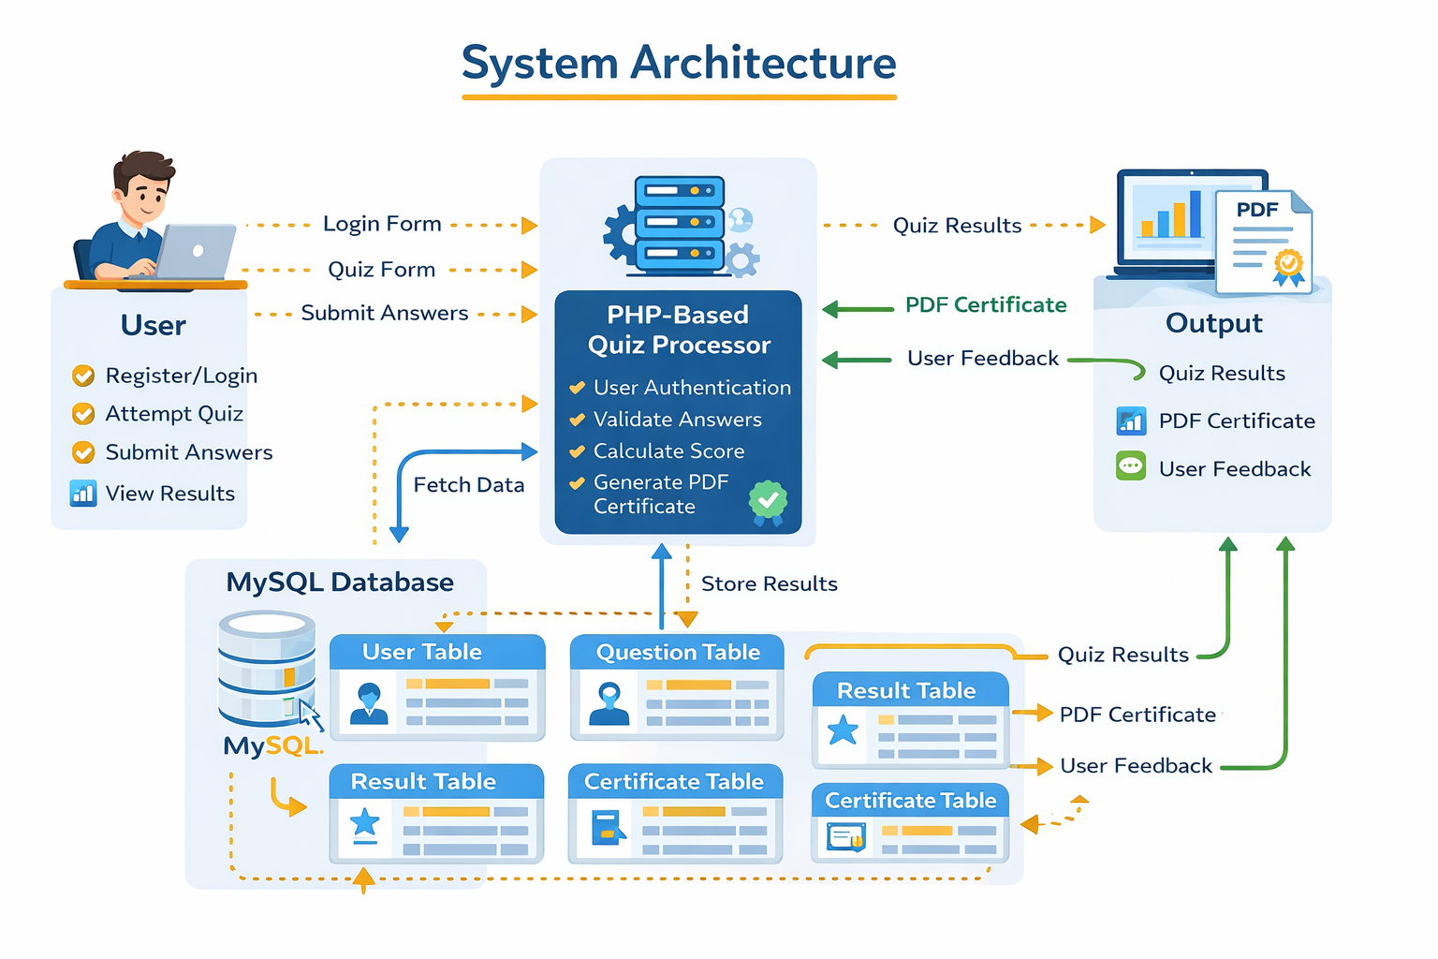

Slide 7
PROPOSED SYSTEM ARCHITECTURE
1. Input
User registers and logs in
User selects and answers quiz questions
Data entered through HTML forms
2. Processing
PHP handles user authentication
Quiz answers are validated
Score is calculated automatically
Pass/fail condition is checked
3. Database
MySQL stores:
User details
Questions and answers
Quiz results
Data is retrieved and updated dynamically
4. Output
Displays quiz score instantly
Shows result (Pass/Fail)
Generates downloadable PDF certificate
Provides user feedback
1
2
3
4
5
6
7
8
9

Slide 8
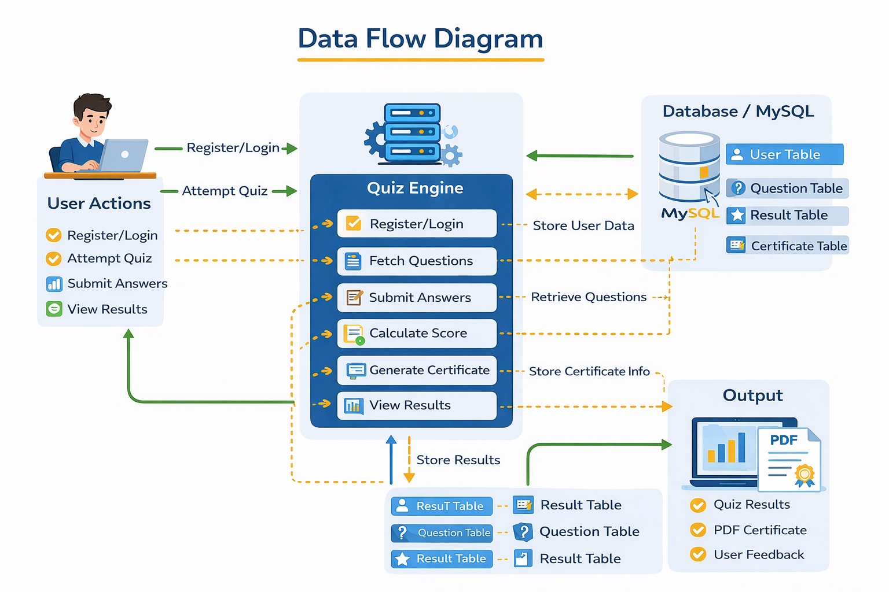
WORKFLOW
(Add dataflow diagram)
1
2
3
4
5
6
7
8
9

Slide 9
TECHNOLOGIES USED
Frontend: HTML5 , CSS3 , JavaScript
Backend: PHP
Database: MySQL
Tools: XAMPP Server , phpMyAdmin , Visual Studio Code (or any code editor) ,Web Browser (Chrome/Edge)
Hardware/Software Requirements:
Hardware: Minimum 4 GB RAM , Intel i3 or above processor ,10 GB free disk space
Software: Windows 10/11 , XAMPP (Apache + MySQL + PHP) , Web Browser (Chrome/Edge)
Code Editor (VS Code / Notepad++)
1
2
3
4
5
6
7
8
9

Slide 10
MODULE DESCRIPTION
Module 1: User Management
Handles user registration, login, and logout functionality. It manages user credentials and maintains session control for secure access to the quiz system.
Module 2: Quiz Processing
Implements the core quiz functionality by displaying questions, capturing user responses, and evaluating answers. It calculates scores and determines pass/fail status.
Module 3: Database Management
Manages storage and retrieval of data such as user details, quiz questions, and results using MySQL. Ensures data consistency and efficient querying.
Module 4: Result & Certification
Displays quiz results instantly and generates a PDF certificate for users who pass the quiz. Stores result history for future reference.
1
2
3
4
5
6
7
8
9

Slide 11
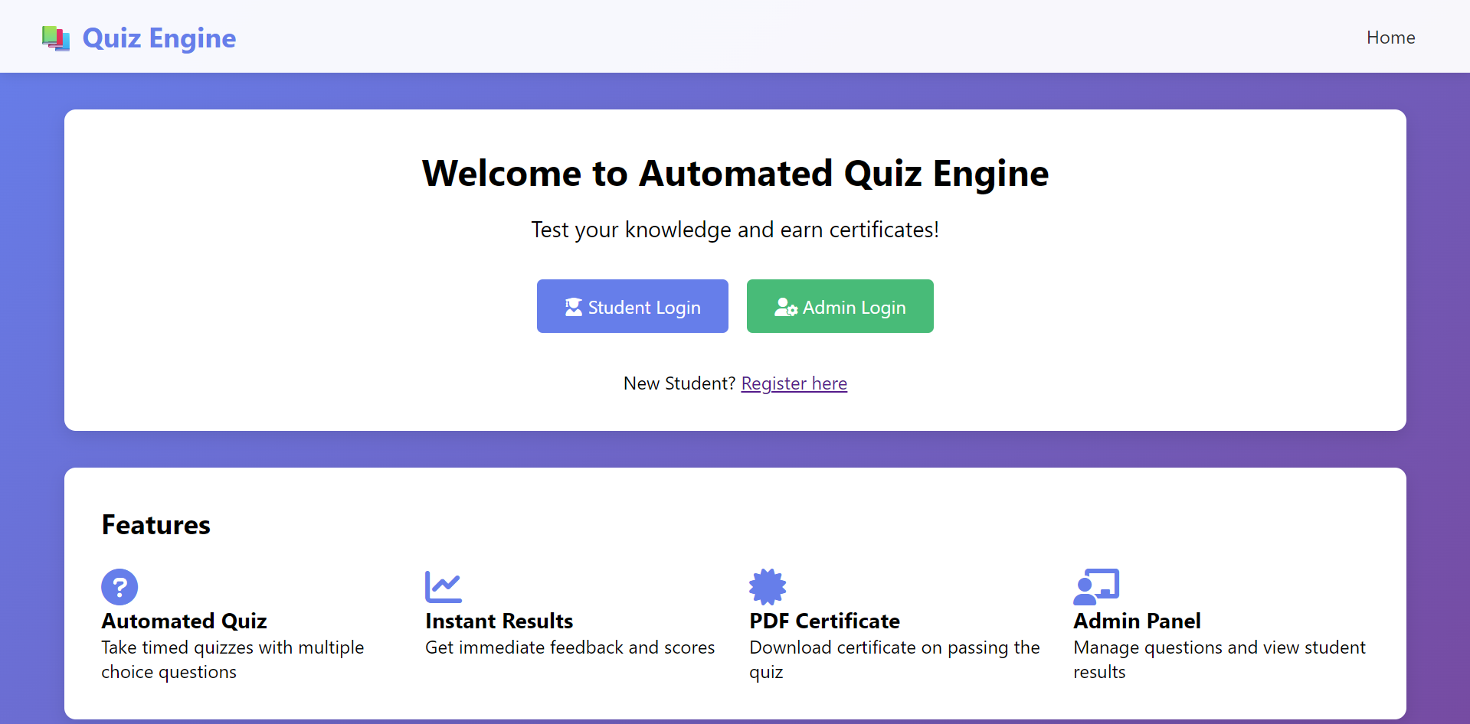
IMPLEMENTATION SCREENSHOTS
1
2
3
4
5
6
7
8
9
User-friendly Automated Quiz Engine interface with student and admin login options. Provides instant results, quiz access, and PDF certificate generation features

Slide 12
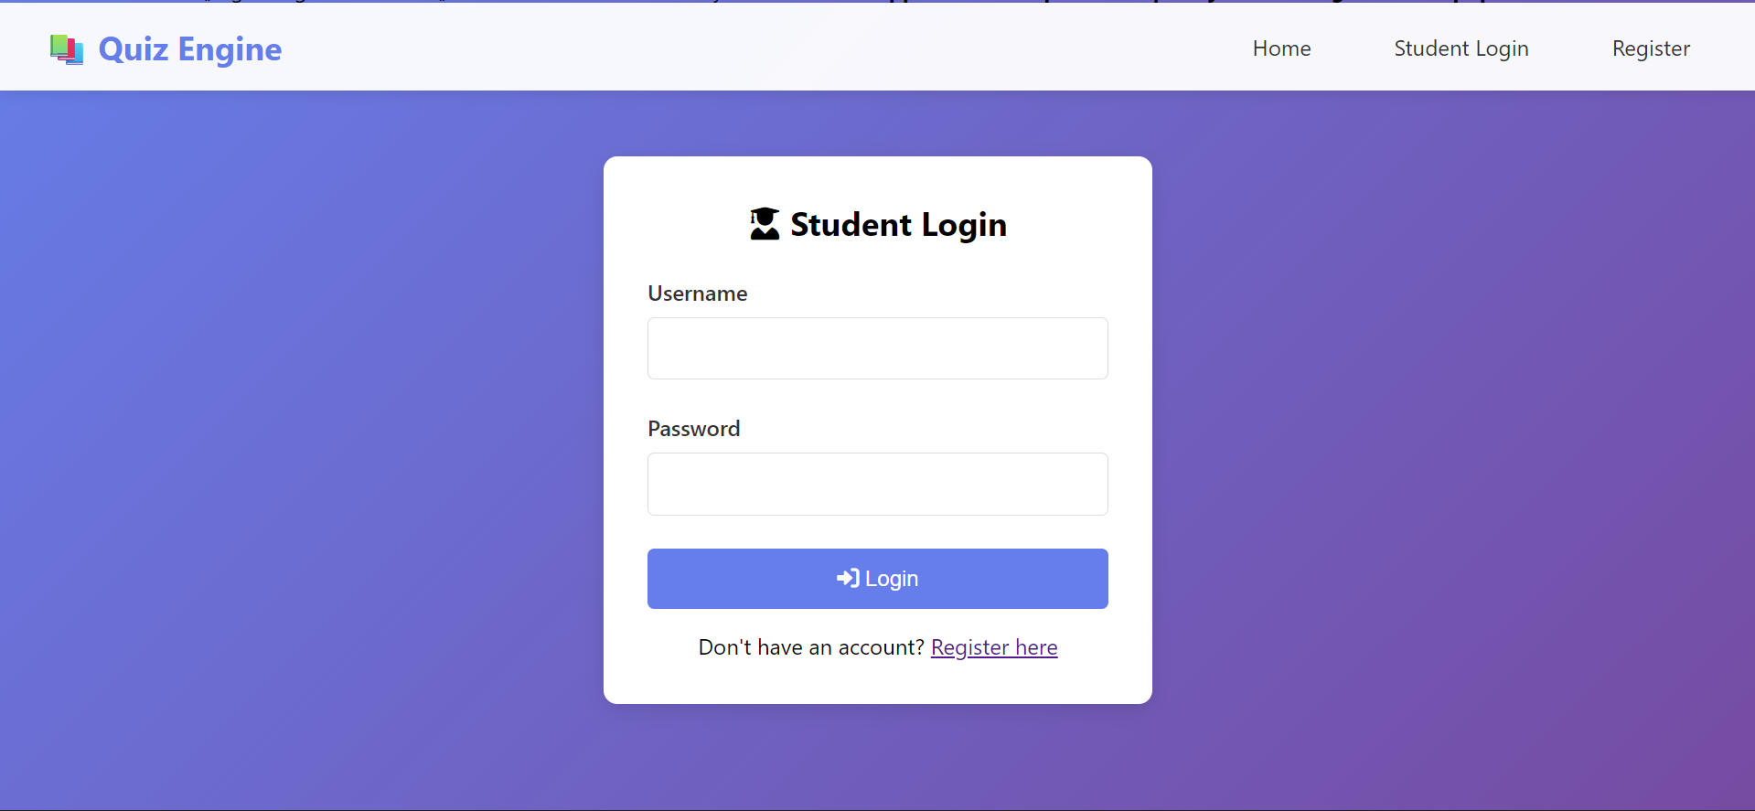
IMPLEMENTATION SCREENSHOTS
1
2
3
4
5
6
7
8(A)
9
Secure student login interface for accessing the quiz system. Allows registered users to authenticate and start quizzes seamlessly

Slide 13
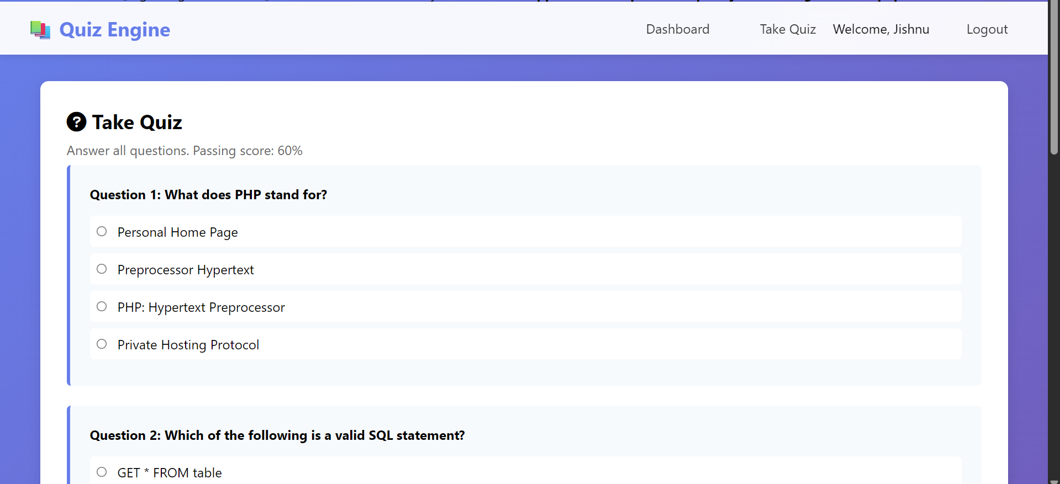
IMPLEMENTATION SCREENSHOTS
1
2
3
4
5
6
7
8(B)
9
Interactive quiz interface displaying multiple-choice questions to the user. Evaluates user responses in real-time to calculate score and determine pass status.

Slide 14
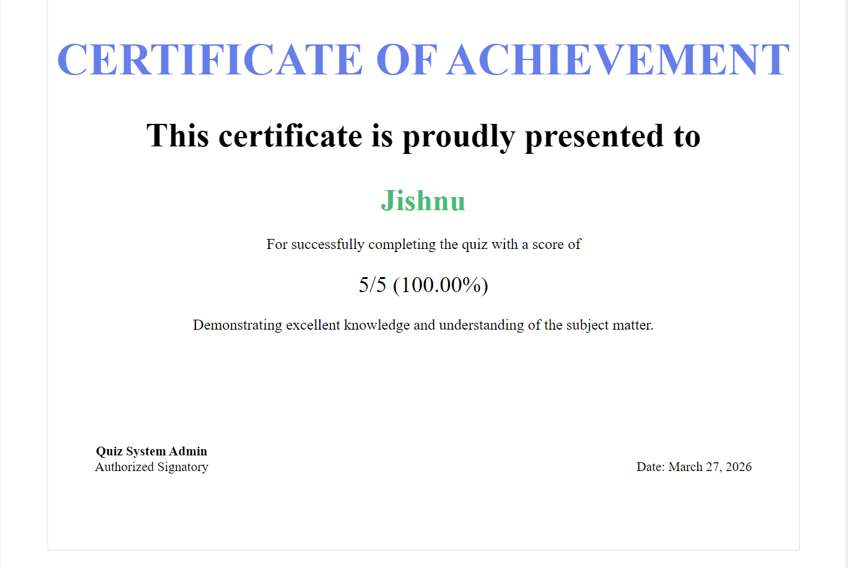
IMPLEMENTATION SCREENSHOTS
1
2
3
4
5
6
7
8(C)
9
Automatically generated certificate awarded upon successful quiz completion. Displays user name, score, and date as proof of achievement

Slide 15
ADVANTAGES & LIMITATIONS
1
ADVANTAGES
Automates quiz conduction, evaluation, and certificate generation, reducing manual effort.
Provides instant results, saving time for both users and administrators.
Reduces human errors in scoring and result processing.
Easy to use and accessible through a web browser.
Stores user data and results securely for future reference.
Scalable system that can be extended with more features like admin panel or analytics.
LIMITATIONS
Requires internet connection or local server to access the system.
Basic security implementation (can be improved with encryption and hashing).
Limited to objective-type questions (MCQs only).
No advanced analytics or reporting features in current version.
Performance may decrease with very large number of users or questions.
2
3
4
5
6
7
8
9

Slide 16
Thank you

